Slide 1
H2S-NN: Heterogeneous Heterophilic Sheaf Neural Network with Path Instances
Progress report · target venue IJCAI-27
Presented by Peeradon Sarnkaew
2026/11/11
Notes:
Good afternoon. I will present H2S-NN, our model for graphs that have many node and edge types and in which connected nodes often have different labels. I will present it as I would at IJCAI: the problem, the idea, the method, how we will test it, and what is still open. The model is final and implemented; the large experiments have not run yet, so you will see no accuracy numbers today.

Slide 2
Reviewer feedback: Overall
Background
Problem
Method
Experiments
Discussion
R1
R2
R3
R4
Meta-review
Reject
split reviews; key claims need support
Weak Accept
Weak Reject
Weak Accept
Weak Reject
main concern: scalability
motivation vs mechanism
heterophily evidence, cost
setting, isolation, cost
Strengths the reviewers agreed on
Strength | Raised by
Path instance kept as a cell, not an endpoint relation: novel | R1–R4, MR
Principled construction, with a proof | R1, R2, R4
Three tasks, many datasets | R1–R4
Cost analysis given; code released | R2
Notes:
Before the new work, here is how the submitted version was received at WSDM 2027. Two reviewers leaned to accept and two to reject; the meta-reviewer recommended rejection. All of them liked the core idea: keeping each concrete meta-path instance as a higher-order cell instead of collapsing it into a relation between its two ends. Three found the construction principled, with the face maps derived from the edge maps. The breadth of tasks was also appreciated. The next slide lists what they asked us to fix, in their own terms.

Slide 3
Reviewer feedback: concerns
Background
Problem
Method
Experiments
Discussion
# | Concern (reviewers’ wording, condensed) | Raised by
1 | Heterophily not shown: only IMDB strongly heterophilic; no gain-vs-heterophily analysis | MR, R2, R3, R4
2 | Face not isolated: it reaches nodes only through the closing (endpoint) edge | MR, R2, R4
3 | No scalability study: ACM 9.3 GB, 3.0 s/epoch | MR, R1, R3, R4
4 | Protocol: baseline tuning unclear; HetSheaf quoted; std unclear | MR, R1, R2, R4
5 | Motivation: no failing example; extra modules not motivated | R2, R3, R4
Concerns 1–3 are about the core claim; 4–5 about how it was tested and explained.
Notes:
These are the five main concerns, condensed but in the reviewers' terms. First, the heterophilic setting was not established: by our own measure only IMDB was strongly heterophilic, the graph-classification datasets only became heterogeneous by treating atom labels as types, and we never related gains to the level of heterophily. Second, and most important technically: reviewer 2 showed that in our model the face reached the nodes only through the synthetic closing edge between the two ends, which is the endpoint view we criticised; and the ablations did not separate the face from schema selection, weighting and extra capacity. Third, cost: 9.3 GB on ACM and no scaling study. Fourth, protocol: baseline tuning was not described and HetSheaf was quoted, not rerun. Fifth, clarity. The first three concern the core claim; the rest concern evaluation and writing.

Slide 4
Update since last meeting
Background
Problem
Method
Experiments
Discussion
Introduction & contribution
Methodology
Path sampling
Experiments
before
before
before
before
3 contributions
H2S-NN + AMPSS + SheafCovPool
closing edge, K steps
face reached nodes via closing edge
AMPSS
schema search + 4 budgets
3 + 4 + 4 datasets
HetSheaf quoted; tuning unclear
now
now
now
now
1 core idea + WISP
paths as faces, original graph
one energy, one solve
matrix-free maps
WISP
random walks; a weight per instance
8 + 8 + 4 datasets
all rerun, one protocol
Status: implemented and tested; ACM memory 9.3 → 2.8 GB. No accuracy runs yet.
Notes:
What changed since the last meeting, in four columns. Contributions: the paper no longer claims AMPSS and SheafCovPool; there is one core idea, path instances as faces with heterophily handled on the original graph, plus WISP as the sampler. Methodology: the closing edge, the K Hodge diffusion steps and the d-by-d maps are gone; faces sit above their paths, propagation is one energy and one solve, and every map is matrix-free, two reflections per edge end, so restriction maps are still there but never built as dense matrices. Path sampling: AMPSS with its schema search and four budgets became WISP. Experiments: from three, four and four datasets with quoted HetSheaf numbers to eight, eight and four datasets with every baseline rerun under one protocol. Status: the model is implemented and passes the theory, gradient and mutation tests, ACM memory went from 9.3 to 2.8 GB, and no accuracy runs have been made yet.

Slide 5
Outline
Background
Problem
Method
Experiments
Discussion
1.
Background
2.
Problem
3.
Method
4.
Experiments
5.
Discussion
Notes:
The talk has five parts. Background gives the four ideas you need: typed graphs, heterophily, meta-paths and sheaves. Problem shows what existing methods do with one concrete path and what they lose. Method presents our answer. Experiments states how each claim will be tested. Discussion separates what is new from what is not.

Slide 6
A heterogeneous graph: nodes/edges have types
Background
Problem
Method
Experiments
Discussion
P4
writes
A7
writes
writes
Node types 𝒯 = {paper, author, subject}
Relation types ℛ = {writes, has-subject, cites}
Paper (Target) Class: Math, Biology
Example: Citation networks, Recommendation Systems
P1
P9
has subject
S3
has subject
paper (colour = field)
author
subject
Types carry meaning: an author neighbour says something different from a subject neighbour.
Notes:
This is the running example for the whole talk. Papers, an author and a subject: nodes have types, and edges have types too, such as "writes" or "has subject". Formally, a heterogeneous graph has a type function for nodes and one for edges. Our task is to predict the field of each paper, shown by colour. Standard benchmarks of this kind are ACM, DBLP, IMDB and Freebase from the HGB benchmark. The point of this slide: a neighbour's type matters, so a model should not treat every neighbour the same way.

Slide 7
Meta-paths: a type pattern versus one concrete path
Background
Problem
Method
Experiments
Discussion
P4
Schema (type pattern): PAP
writes
writes
A7
P
A
P
PAP ≈ “two papers share an author”
P1
P9
APA ≈ “Co authors”
Instance (PAP)
P1 – A7 – P9: P1 and P9 share A7
P1 – A7 – P4: P1 and P4 share A7
A7 is the intermediate node
S3
Meta-paths [4] are the standard tool for typed multi-hop relations. It can encode semantic meanings
Notes:
A meta-path schema is a type pattern: paper, author, paper means two papers share an author. An instance is one concrete path that follows it, such as P1, A7, P9. The middle node, A7, is the intermediate node. Our research question is about this node: does it matter who A7 is, and should A7 itself learn that P1 and P9 are linked? Keep this question in mind; every later slide answers part of it.

Slide 8
Heterophily: connected nodes have different labels
Background
Problem
Method
Experiments
Discussion
Homogeneous
Homophily
Homogeneous Heterophily
Heterogeneous Heterophily
P4
A7
P1
P9
S3
Average the neighbours → label is kept
Average the neighbours → labels are blurred
P1 and P9 share author A7, but work in different fields
Being connected does not mean being similar; plain averaging (GCN) can hurt.
Notes:
A GCN updates a node with the average of its neighbours. That works when neighbours share the label, which we call homophily, left. It fails under heterophily, right: neighbours have different labels and averaging mixes them. The simplest measure is edge homophily: the fraction of edges whose two ends have the same label. Near one is homophilic, near zero heterophilic. In our example P1 and P9 share author A7 but are in different fields. So being connected does not mean being similar, and that is the first difficulty.

Slide 9
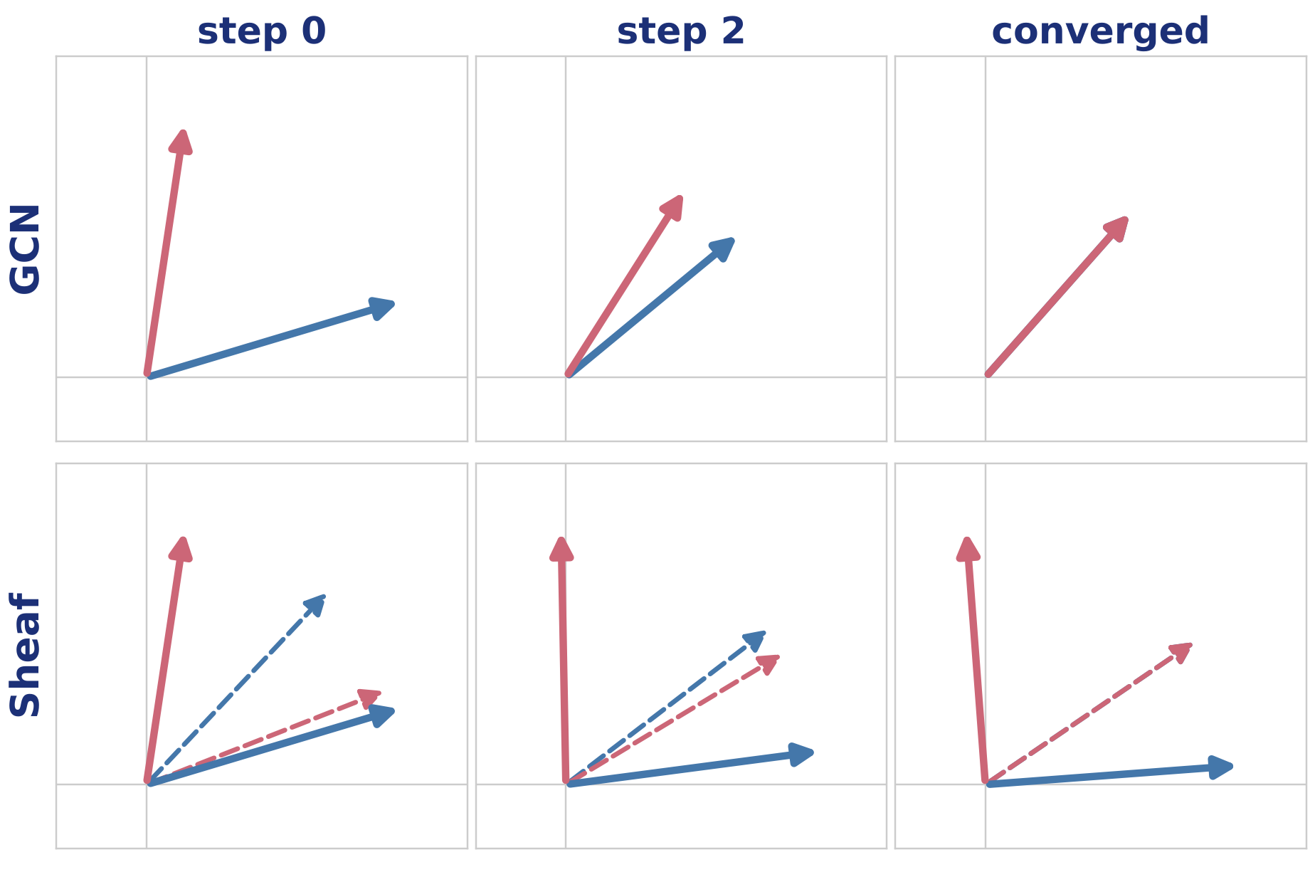
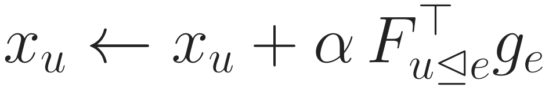
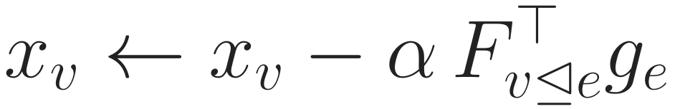
Sheaf diffusion: agree inside the edge, stay different
Background
Problem
Method
Experiments
Discussion
One step moves both nodes
Both move to close the gap inside e
GCN: F = I, so the gap is xᵥ − xᵤ: they merge
Example: Fᵤ rotates +30°, Fᵥ rotates −60°.
Converged: xᵤ ≈ east, xᵥ ≈ north (cleaned, still different); inside e both point the same way.
xᵤ
xᵥ
Fᵤ◁ₑxᵤ
Fᵥ◁ₑxᵥ (inside e)
Diffusion removes only the disagreement the maps cannot explain, so each node keeps its class.
GCN [2] · sheaf networks [7, 8] · HetSheaf [9]
Notes:
Two neighbours of different classes: u, blue, roughly east; v, pink, roughly north. Each end of the edge has its own map into the edge's space: here u's map rotates by plus thirty degrees and v's by minus sixty. The dashed arrows are the two nodes as the edge sees them. One diffusion step computes the gap inside the edge and moves both nodes, u by F_u-transpose times the gap and v the opposite way, so both original vectors move. Top row: GCN has identity maps, so the gap is just the difference of the two vectors and they merge into one, losing the class. Bottom row: with maps, the dashed arrows meet inside the edge, while u ends almost exactly east and v almost exactly north: the small noise is removed and the classes are kept. That is the whole idea of a sheaf: agreement is required only after the maps.

Slide 10
How heterophily is handled: decompose, then fuse
Background
Problem
Method
Experiments
Discussion
1 Original graph
2 One graph per schema
3 Encode each view
4 Fuse
P4
PAP view
P9
GNN on this view
heterophily handled here
A7
P1
P4
attention over views → ŷ
P1
P9
S3
PSP view
GNN on this view
heterophily handled here
P1
P9
A7 and S3 are gone
Heterophily is studied indirectly: on derived graphs, one per meta-path schema, then fused.
Decompose-then-fuse [18, 20, 21] · schema-level encoders [10, 11] · per-schema instance encoders [12, 22]
Notes:
How do current methods handle a graph that is both heterogeneous and heterophilic? Most of them first decompose it. Step one is the original graph. Step two builds one paper-only graph per meta-path schema: in the PAP view P1 is linked to P9 and P4 because they share an author; in the PSP view P1 is linked to P9 because they share a subject. Notice that A7 and S3 are no longer in either graph. Step three runs a network on each view, and this is where heterophily is handled, for example by separating homophilic and heterophilic neighbours of the derived graph. Step four fuses the views, usually with attention. Hetero2Net, HDHGR and LatGRL follow this pattern for heterophily; HAN and SeHGNN do the same for heterogeneous graphs in general; even MAGNN, which keeps instances, processes each schema separately.

Slide 11

Two limitations of decompose-then-fuse
Background
Problem
Method
Experiments
Discussion
Limitation 1 judged on derived graphs
Limitation 2 pairs differ only by their endpoints
One homophily per view
Original typed edges never used
Depends on a hand-made schema list
P1
A7
P9
P1
P9
P1
A2
P9
one edge, weight 2
Only a count survives
A7 never learns P1–P9 are linked
Goal: heterophily on the original graph, one model.
Goal: path instances act as structure.
Both limitations come from the same step: the graph is replaced by schema views before learning starts.
Notes:
Decompose-then-fuse has two limitations. Left: heterophily is judged and handled on the derived graphs, one homophily value per view, not on the original typed graph; the original edges such as P1 to A7 never enter the computation, and which neighbours count depends on a hand-picked schema list. Right: within one schema, two paper pairs are distinguished only by their endpoints. The PAP view is the matrix product of paper-author and author-paper adjacency, so its entry for P1 and P9 is just the number of shared authors. Whether the path goes through A7 or A2 makes no difference, and A7 itself never learns that P1 and P9 are linked. Both limitations come from replacing the graph by schema views before learning starts. Our two goals answer them one to one.

Slide 12
Our view and the research questions
Background
Problem
Method
Experiments
Discussion
Our view
P4
Running question
Does it matter who A7 is? Should A7 learn that P1 and P9 are linked and are part of meta-path?
Heterophily on the original graph
no per-schema views
A7
1
P1
P9
2
Meta-paths are structure, not input
each path instance is a face
S3
RQ1
Can a single model on the original graph handle heterophily using path instances, without per-schema branches?
3
Face attached to its nodes and edges
no closing edge
4
A learned weight per instance
from its nodes and relations
RQ2
Do path instances, used as structure, carry information that schema-level encoders and instance-level features do not?
Notes:
Our view, in four points. Heterophily is handled on the original graph. Meta-paths are part of the structure the model operates on, not extra input. Each sampled path instance becomes a face attached to the nodes and edges it traverses, with no closing edge, so the path does not need to return to its start. And each instance has its own learned weight. This gives two research questions. RQ1: can a single model on the original graph handle heterophily using path instances, without per-schema branches? RQ2: do path instances, used as structure, carry information that schema-level encoders and instance-level features do not? In terms of our example: does it matter who A7 is, and should A7 itself learn that P1 and P9 are linked?

Slide 13
Related work: where each family puts the path
Background
Problem
Method
Experiments
Discussion
Family | Works on the original graph | Uses the path instance | Updates the intermediate node | Where heterophily is handled
Decompose-then-fuse Hetero²Net, HDHGR, LatGRL [18, 20, 21] | ✗ | ✗ | ✗ | per derived view
Schema-level encoders HAN, SeHGNN [10, 11] | ✗ | ✗ | ✗ | not targeted
Instance encoders MAGNN, MECCH [12, 22] | ✗ | ✓ as a feature | ✗ target only | not targeted
Sheaf networks NSD, HetSheaf [8, 9] | ✓ | ✗ edges only | n/a | learned edge maps
Cell / hypergraph networks CWN, sheaf hypergraphs [13, 14] | ✓ | partly free maps | ✓ | not targeted
H2S-NN (ours) | ✓ | ✓ as a face | ✓ | edge maps + path compositions
No family both stays on the original graph and lets one path update all of its nodes.
Notes:
Here are the families, compared on the properties our questions need. Decompose-then-fuse methods for heterophily, such as Hetero2Net, HDHGR and LatGRL, and schema-level encoders such as HAN and SeHGNN, work on derived graphs and never see an instance. Instance encoders such as MAGNN and MECCH do use the instance and its intermediate node, but as a feature written into the target node only; A7 is not updated. Sheaf networks such as NSD and HetSheaf stay on the original graph and handle heterophily with learned edge maps, but they only see edges. Cell-complex and sheaf-hypergraph networks update every node of a cell, but their cell maps are free and they do not target typed graphs or heterophily. Our model is the row at the bottom: on the original graph, the instance as a face, every node updated, and heterophily handled by edge maps and their compositions along the path.

Slide 14
Objectives and contributions
Background
Problem
Method
Experiments
Discussion
Objectives (what we must show)
Contributions
O1
One model on the original graph handles heterophily, no per-schema branch (RQ1)
1
Path instances as faces of the graph’s sheaf
maps composed from edges; reaches every node; no closing edge
2
One energy, one solve
unique for any parameters; no depth to tune
O2
Paths as structure beat schema encoders and instance features (RQ2)
3
WISP: schema-free sampling
random walks, unbiased; a learned weight per instance
Every comparison our questions need is a configuration of the same model on the same sampled paths.
Notes:
Two objectives follow from the questions. O1: show that one model on the original graph handles heterophily with path instances and without per-schema branches. O2: show that path instances, used as structure, carry information beyond schema-level encoders and beyond instance-level features. Three contributions deliver this. First, path instances become faces of the same sheaf that lives on the graph: their maps are compositions of the edge maps, and every node of the instance receives the face, intermediate nodes included, with no closing edge. Second, node representations are the minimiser of one energy over nodes, edges and faces, which has a unique solution for any parameter values and no depth to tune. Third, WISP samples instances by random walks without a schema list, with unbiased weights, and learns a weight per instance. Because everything is one energy, the comparisons we need are configurations of the same model.

Slide 15

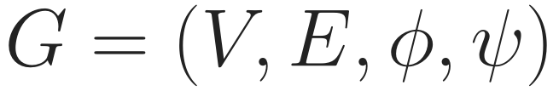
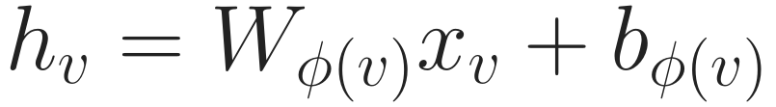
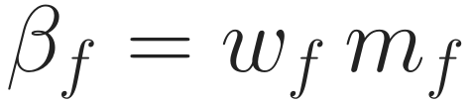
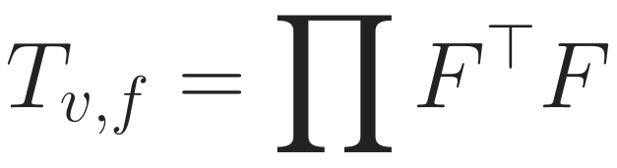
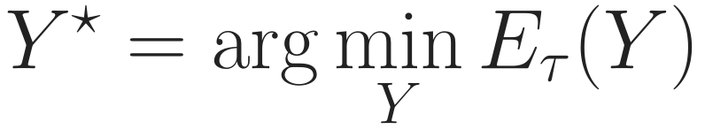
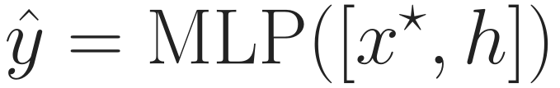
H2S-NN in one picture
Background
Problem
Method
Experiments
Discussion
Overview
Encode
WISP
Faces
Energy
Solve
Train
1 Input
2 Encode
3 Sample faces
4 Build sheaf
5 Solve
6 Predict
f
MLP
Y* = minimiser
node
link
graph
types on nodes and edges
every type in one d-dim space
random walks, a weight each
learned edge maps; face maps composed
agree after maps, stay near h
own + propagated
training gradient: one extra solve, no unrolled layers
Notes:
Here is the whole model in six steps. One, the input is the typed graph itself; no meta-path list is given. Two, a type-specific encoder puts every node, whatever its type, into the same d-dimensional space; that vector is h. Three, WISP samples path instances by random walks, and each instance becomes a face with a weight beta. Four, we build a sheaf: each edge gets learned maps for its two ends, and each face gets maps that are compositions of the edge maps along its path. Five, node representations are the minimiser of one energy: stay close to h, and agree with neighbours after the maps. Six, a small MLP reads the node's own encoding and its propagated state and makes the prediction for the task: node, link or graph. Training sends the gradient back, in red, through one extra linear solve rather than through unrolled layers. The next slides go through each step with its equation.

Slide 16
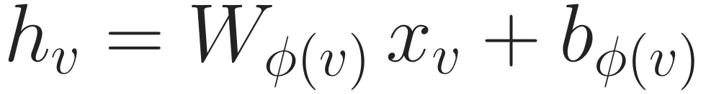
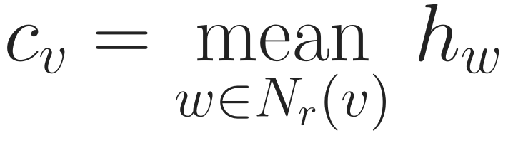
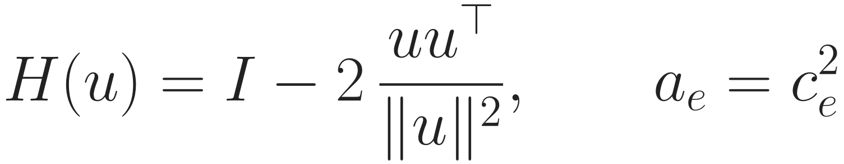
Step 1–2: encode nodes, learn a map for each edge end
Background
Problem
Method
Experiments
Discussion
Overview
Encode
WISP
Faces
Energy
Solve
Train
map MLP reads both ends
P1, A7, relation, role
type encoder (no features: a learned vector)
FP1◁e
FA7◁e
context: neighbour mean per relation
P1
e
A7
edge-end map: frame × two reflections
Rotates or reflects, never shrinks
Depends on who both ends are
Role frames keep direction
reflections read both ends
reflection; aₑ = edge weight
Computed once per forward pass: the same maps are used by edges and, composed, by faces.
Notes:
Steps one and two. Each node type has its own linear encoder into a shared d-dimensional space; types without features get a learned vector per node. We also compute a context c: the mean of the neighbours' encodings, separately for each relation and role. Then every end of every edge gets a map. The map is a fixed frame for the relation and the role, times two Householder reflections whose vectors come from a small network that reads both ends of the edge. So the map from A7 into the edge depends on who A7 and P1 are, not only on their types, and source and target roles have different frames, which keeps direction. Because the map is orthogonal, it rotates or reflects and never shrinks a vector. Each edge also gets a positive weight a_e. All of this is computed once per forward pass.

Slide 17
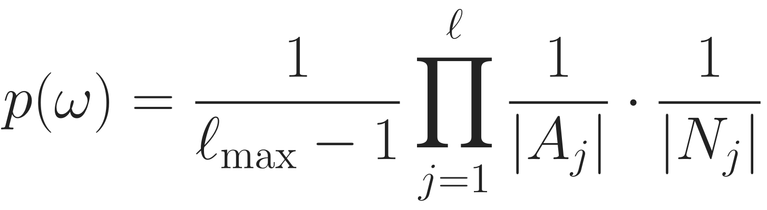
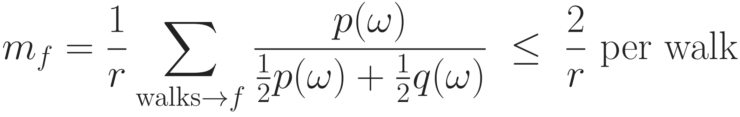
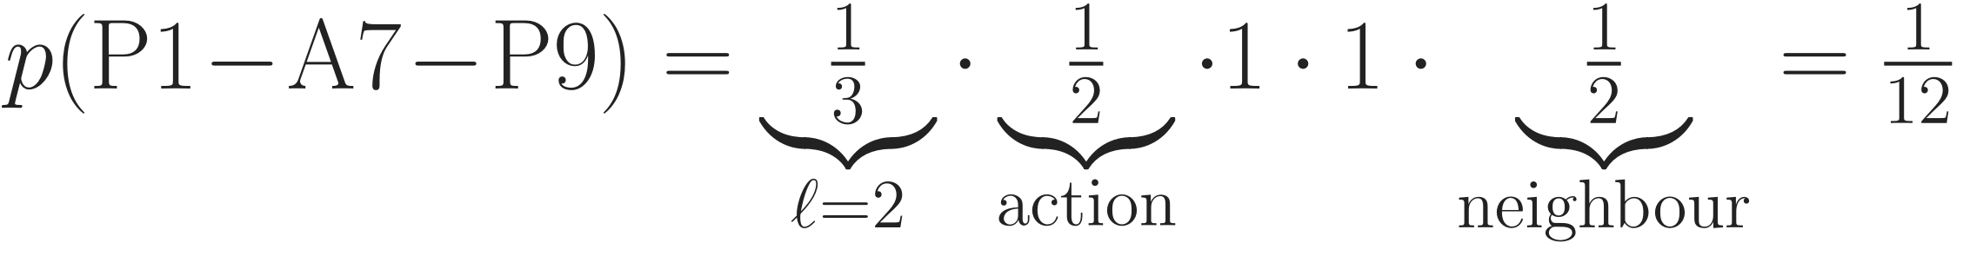
WISP (1): sample path instances by random walks
Background
Problem
Method
Experiments
Discussion
Overview
Encode
WISP
Faces
Energy
Solve
Train
All length-2 walks from P1, and their probability
½
P9
p = 1/12
A7
½
½
uniform length; then uniform action Aⱼ and unvisited neighbour Nⱼ
P4
p = 1/12
P1
½
1
sampling correction; r walks per node
S3
P9
p = 1/6
One walk = one face (ℓmax = 4)
New walks every epoch
No schema list, no labels
Unbiased: on average the sampled faces give the operator of the stated walk distribution p.
Notes:
WISP, the sampler, step by step on our example. From P1 we first draw a length, uniformly between 2 and l-max; with l-max 4 the length 2 has probability one third. At each hop we choose uniformly among the actions, meaning relation and direction, that still have an unvisited neighbour: from P1 that is author or subject, one half each. Then we choose a uniform unvisited neighbour: from A7 that is P9 or P4, one half each. So P1-A7-P9 has probability one twelfth, P1-A7-P4 also one twelfth, and P1-S3-P9 one sixth. Each walk becomes one face. The weight m_f corrects for how we sampled: walks come from a fifty-fifty mix of p and an optional proposal q, which bounds each correction by 2 over r; with the default q equal to p, m_f is simply the number of walks that hit the face divided by r. On average, the sampled faces reproduce the operator of the walk distribution p exactly. Walks are redrawn every epoch, one fixed draw is used for evaluation, and no schema list or label enters.

Slide 18
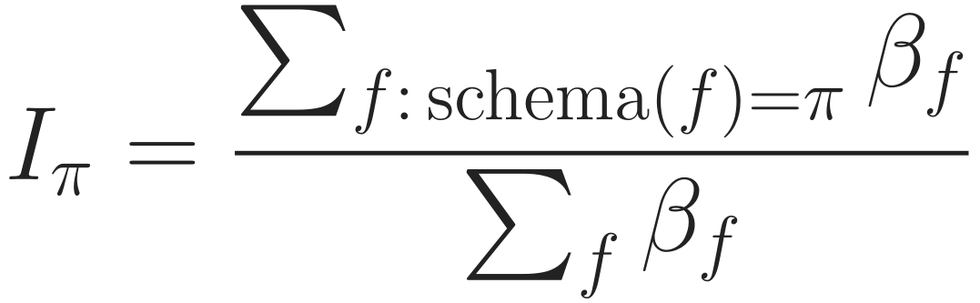
WISP (2): a learned weight for every instance
Background
Problem
Method
Experiments
Discussion
Overview
Encode
WISP
Faces
Energy
Solve
Train
Same schema PAP, different weight
all nodes and relations, in order
P1
A7
P9
w high
g: one small MLP per path length
P1
A2
P9
w low
Line width = learned weight (illustration)
schemas read out
v1: schema search + 3 budgets → WISP: no schema step
The weight sees who is on the path, so two instances of one schema can count very differently.
Notes:
The second half of WISP is the weight. For each face we collect the encodings of all its nodes and the embeddings of its relations, in order; call this xi. A small network g, one per path length and shared by all schemas, turns xi into a log-weight, so w_f is positive. Multiplying by the sampling correction m_f gives beta_f, the face weight used in the energy. Because g sees who is on the path, two PAP instances, one through A7 and one through A2, can count very differently. Schemas are not selected at all; after training we can read out how much of the total weight each schema received, which gives the interpretability that schema selection used to give. Compared with v1: AMPSS enumerated schemas by depth-first search, selected some, and needed several budgets; WISP has no schema step.

Slide 19
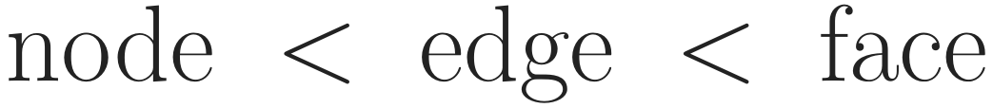
Step 3: a path instance becomes a face
Background
Problem
Method
Experiments
Discussion
Overview
Encode
WISP
Faces
Energy
Solve
Train
Structure: an order on cells
z
faces (state z)
Face sits above its nodes and edges
Coupled: node–edge, edge–face, node–face
States x, s, z are solved for
No loop, no closing edge
s₁
s₂
edges (state s)
P1
A7
P9
nodes (state x)
no P1–P9 edge, not even implicitly
A7 is inside the computation: it is coupled to the face directly and through its two edges.
Notes:
Step three: what a face is. We keep the path on the original graph and add one new element, the face, above it. Formally the cells are ordered: a node is below the edges that contain it, and an edge and a node are below every face whose path uses them. Every comparable pair is coupled: node with edge in orange, edge with face in green, node with face directly in dashed pink. Each cell has a state that the model solves for: x on nodes, s on edges, z on faces. Important for the reviewers' main criticism: the path is never closed into a loop. There is no edge between P1 and P9, neither in the computation nor in the definition. So A7 is inside the computation: it is coupled to the face directly and through both of its edges.

Slide 20
Face maps are composed from edge maps
Background
Problem
Method
Experiments
Discussion
Overview
Encode
WISP
Faces
Energy
Solve
Train
What this buys
P1
e₁
A7
e₂
P9
No new parameters
Depends on who A7 is
Relation order matters
Never contradicts the graph
Free maps [15] lose this
A7 → into e₁ → read in P1’s frame
node → face: walk the path edge by edge
on the example (P1’s frame is the face frame)
edge → face; every route gives the same map
A face compares its nodes after carrying them along its own edges.
Notes:
How does a face compare P1, A7 and P9, which live in different frames? It reuses the edge maps. To bring A7 into the face, which uses P1's frame, we apply A7's map into edge e1 and then read the result back in P1's frame with the transpose of P1's map. For P9 we continue through edge e2. In general the node-to-face map T is the product of these steps along the path, and the edge-to-face map R is defined the same way; with these choices every route through the cells gives the same result, which is what makes this a sheaf. What this buys: faces add no parameters; the face map depends on who A7 is, through its edge maps; the order of relations matters; and a state that is consistent on the graph stays consistent after faces are added, so a face adds evidence and never a contradiction. With free per-face maps this last property is lost; we checked that numerically.

Slide 21
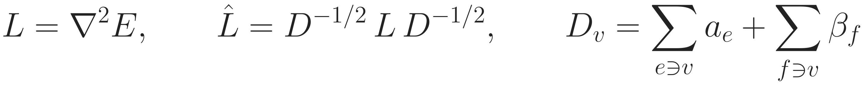
Step 4: one energy over nodes, edges and faces
Background
Problem
Method
Experiments
Discussion
Overview
Encode
WISP
Faces
Energy
Solve
Train
node–edge
edge–face
node–face
Symbol | Meaning | Intuition
x, s, z | node, edge, face states; Y = (x, s, z) | what the model solves for
a, β | edge weight, face weight (WISP) | how much each agreement counts
F, R, T | maps: F learned; R, T composed from F | compare only after the maps
s | meeting point of an edge’s ends and its faces | faces sharing an edge must agree there
z | meeting point of all cells of one path | the instance’s own state
normalised so hubs do not dominate
Every pair of cells that touch must agree after the maps; nothing else is compared.
Notes:
Step four is the single energy of the model. It has three kinds of terms, each a disagreement after the maps. Orange: a node and an edge that contains it. Green: an edge and a face that uses it. Pink: a node and a face that passes through it. Edge weights a and face weights beta scale them. The edge state s is the place where both ends of an edge and every face through it must meet, so two faces that share an edge are tied together there; the face state z is the meeting point of all nodes and edges of one path. The direct node-face term matters: without it a face could never pull a node harder than the node's own edges do. L is the matrix of this quadratic energy, and we normalise it by its diagonal so that high-degree nodes do not dominate.

Slide 22
Every node of the path hears the face
Background
Problem
Method
Experiments
Discussion
Overview
Encode
WISP
Faces
Energy
Solve
Train
Coupling in the operator | v1: Hodge diffusion + closing edge | H2S-NN
face → P1 | 0 for any number of steps | direct
face → A7 (intermediate) | 0 for any number of steps | direct
face → P9 | 0 for any number of steps | direct
P1 ↔ P9 shortcut | yes (closing edge) | none
f
P1
A7
P9
all three receive the face in one application
v1: face→node block is exactly 0 (proved); only the closing edge remained.
This removes the cause of reviewer concern 2 by construction; whether it helps accuracy is tested later.
Notes:
This answers the reviewers' main technical criticism. In v1 we used Hodge diffusion on a complex with a closing edge. There, the block that sends face information to nodes is exactly zero for any number of diffusion steps; we proved it and checked it numerically. The only route from the face to the nodes was the closing edge between the two ends, which is the endpoint view we argued against. In the new energy, the node-face term puts the face directly into every node's update, including A7, and there is no coupling between P1 and P9 at all except through the face or shared edges. This is structural, by construction. Whether it improves accuracy is a separate question that the experiments must decide.

Slide 23
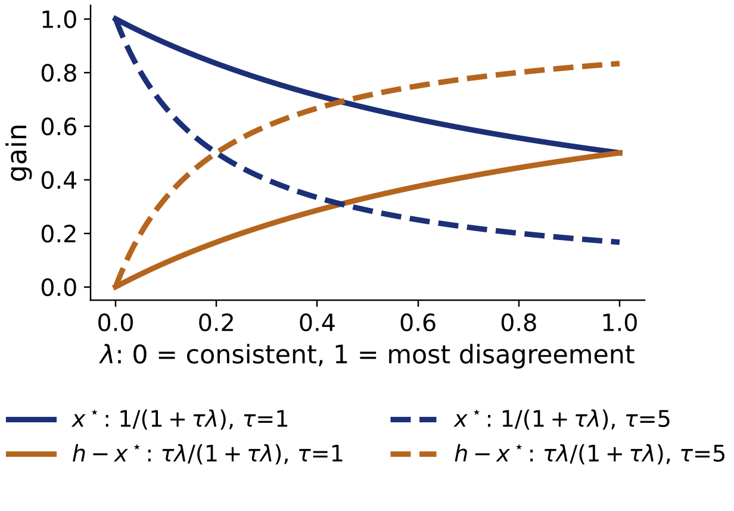

Step 5: propagation = the minimiser of the energy
Background
Problem
Method
Experiments
Discussion
Overview
Encode
WISP
Faces
Energy
Solve
Train
Node view (other states eliminated exactly)
τ learned; P picks nodes
Unique answer for any parameters
No depth; ≈ 10 CG steps
No faces → PageRank on a sheaf [16]
ego kept separate [3]
This objective defines the representation; the training loss comes next and is a different thing.
Notes:
Step five. Instead of stacking layers, the node representation is the minimiser of one objective. The first term keeps each node close to its own encoding h, which is what preserves identity; the second is our energy, scaled by one learned number tau. Setting the gradient to zero gives one linear system, solved by conjugate gradient, about ten steps on the HGB datasets. If we eliminate the edge and face states, which can be done exactly, the node representation is the inverse of identity plus tau S-hat applied to h, where S-hat is the node-level operator that already contains the faces. The plot shows what this does per frequency: the propagated part x-star keeps the smooth components and damps disagreement; the difference h minus x-star is the complementary high-pass part. The classifier reads both x-star and h, so it can use either, which matters under heterophily. Two clarifications: the system is positive definite, so there is exactly one answer for any parameter values; and without faces this is personalised PageRank on a sheaf, so the novelty is the operator, not the solver. This objective is not the training loss; that comes next.

Slide 24
What is learned, and what the loss is
Background
Problem
Method
Experiments
Discussion
Map
Goal
Step 0
Fix 1
Fix 2
WISP
Solve
Learn
RQ
Component | Parameters | Enters 𝒥 as
Type encoders | W_t, b_t per node type | h
Edge maps | MLP → 2 reflection vectors per edge end; frame per (relation, role) | F
Edge weights | MLP → aₑ > 0 | aₑ
Instance weights (WISP) | MLP g per path length → β_f > 0 | β_f
Strength | τ = e^θ, one scalar | τ
Head | MLP on [x*, h] | – (after the solve)
gradient: one adjoint solve with the same matrix; memory ∝ states, not solver steps
Not learned: face maps T (composed from F), the walk sampler, the solver.
ℒ: cross-entropy (node, graph), binary (IMDB, links). 𝒥 is not the loss: it defines the forward pass.
The task loss shapes F, a, β and τ; that is how the model learns what “agree” means on each graph.
Notes:
What is learned and what the loss is. The learned parts are the type encoders, the edge-map network that outputs two reflection vectors per edge end plus a frame per relation and role, the edge-weight network, the instance-weight network g, one scalar tau, and the head. The face maps T are composed from F, and the sampler and solver have no parameters. The training problem is: minimise the task loss of the head applied to x-star and h, where x-star is the minimiser of the objective. So the objective J is not the loss; it defines the forward pass, and the loss is the usual cross-entropy or binary cross-entropy. The gradient reaches every parameter through one adjoint solve with the same matrix, so memory is proportional to the states and not to the number of solver steps. This is also the answer to 'where do the maps come from': the task loss shapes them, so the model learns what agreement means on each graph.

Slide 25
How the method answers the research questions
Background
Problem
Method
Experiments
Discussion
Map
Goal
Step 0
Fix 1
Fix 2
WISP
Solve
Learn
RQ
 | Mechanism in the model | Where it is tested
RQ1 heterophily, original graph, no per-schema branch | edge maps F (agree after a map); anchor to h; head reads [x*, h]; one objective on the original graph | gain vs. ℋ² across 8 datasets; maps → identity; vs. Hetero²Net, HetSheaf, R-GCN
RQ2 path instances as structure | face state z_f; maps T composed in path order; weight β_f from all nodes of the path; every node on the path updated | no faces; face → closing edge; face → feature; weight uniform / endpoints; known-answer task
Both | WISP: candidates without a schema list; selection per instance, end-to-end | expert list on the same model; LMSPS schemas (proposed); ℓmax curve
Each mechanism was added for one requirement; each has an ablation that can remove it.
Notes:
Finally, how the method maps onto the research questions. RQ1, heterophily on the original graph without per-schema branches, is carried by the edge maps, the anchor to h, the head reading both parts, and the fact that there is one objective on the original graph; it is tested by the gain against H-squared across the eight datasets, by replacing the maps with the identity, and by comparison with Hetero2Net, HetSheaf and a tuned R-GCN. RQ2, path instances as structure, is carried by the face state, the composed maps, the per-instance weight and the fact that every node on the path is updated; it is tested by removing faces, replacing them with closing edges or features, restricting the weight, and by a known-answer task. WISP serves both: candidates without a schema list, selection per instance. Every mechanism was added for one requirement, and every one has an ablation that can remove it.

Slide 26
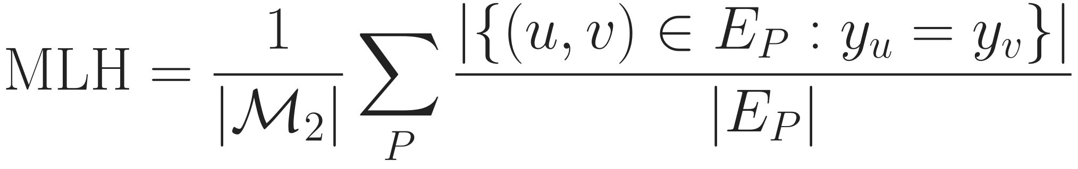
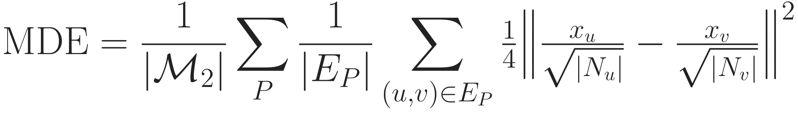
Heterophily metrics: labels (MLH) and features (MDE)
Background
Problem
Method
Experiments
Discussion
Data
Metrics
Protocol
Cost
Ablation
Analysis
MLH: do linked nodes share a label?
MDE: do linked nodes look alike?
E_P: edges of the graph meta-path P induces; y: label
Purpose: near 1 homophilic, near 0 heterophilic
x: raw features; N: neighbours in E_P
Purpose: large = feature heterophily; per dataset only
ℳ₂: length-2 meta-paths from Hetero²Net [18] (ACM PAP, PSP, PTP; DBLP APA; IMDB MDM, MAM, MKM), same set for MLH, ℋ², MDE. First reproduce Hetero²Net’s published values.
Labels and features can disagree; reporting both answers concern 1.
Notes:
Two heterophily metrics complement H-squared from the background. MLH, from Hetero2Net: for each length-two meta-path, build the graph it induces on target nodes and count the fraction of edges whose ends share a label; average over meta-paths. Near one is homophilic. On our toy PAP graph it is one half. MDE looks at features instead of labels: the average degree-normalised feature difference across meta-path edges; large means linked nodes look different. It depends on feature scale, so it describes a dataset rather than ranking datasets. All three metrics use the same meta-path list, and we first reproduce Hetero2Net's published values.

Slide 27
Datasets (1): node classification, small to large
Background
Problem
Method
Experiments
Discussion
Datasets
Heterophily
Metrics
Protocol
Cost
Ablation
Analysis
Dataset | Source | Nodes | Node types | Target (classes) | Training
ACM | HGB [1] | 10,942 | 4 | paper (3) | full graph
DBLP | HGB [1] | 26,128 | 4 | author (4) | full graph
IMDB | HGB [1] | 21,420 | 4 | movie (5, multi-label) | full graph
Freebase | HGB [1] | 180,098 | 8 | book (7) | full graph*
IEEE-CIS-G | H2GB [5] | 153,880 | 12 | transaction (2) | full or mini-batch
mag-year | H2GB [5] | 1,939,743 | 4 | paper (5) | mini-batch
ogbn-mag | H2GB [5] | 1,939,743 | 4 | paper (349) | mini-batch
H-Pokec | H2GB [5] | 1,731,977 | 16 | user (2) | mini-batch
Splits: HGB 24/6/70, H2GB its own. *Freebase memory not yet measured
Four HGB graphs plus four large H2GB graphs, chosen to span the heterophily range.
Notes:
Node classification uses eight datasets. Four come from HGB: ACM, DBLP, IMDB and Freebase, trained on the full graph with HGB's official 24/6/70 splits. Four come from H2GB, the large benchmark for heterophilic heterogeneous graphs: IEEE-CIS-G for fraud, mag-year and ogbn-mag on the same academic graph with different targets, and the social network H-Pokec, with their own splits. The three large ones need mini-batch training, which still has to be designed. The rule for every dataset: it must have node attributes or target labels. This set answers reviewer concern 1: it spans the heterophily range, not just IMDB.

Slide 28
Datasets (2): link prediction and graph classification
Background
Problem
Method
Experiments
Discussion
Datasets
Heterophily
Metrics
Protocol
Cost
Ablation
Analysis
Link-prediction task | Graph | Target relation
ACM P–A, DBLP A–P, IMDB M–A | HGB, derived | paper–author, author–paper, movie–actor
Freebase B–B | HGB, derived | book–book (split by unordered pair)
PubMed, LastFM | HGB link sets | disease–disease, user–artist
ogbn-mag P–P, H-Pokec U–U | H2GB graphs | citation, friendship (large)
Leaking features removed in every task.
Graph classification (appendix) | Graphs | Classes | Types
MUTAG, PROTEINS, ENZYMES, NCI1 (TU [23]) | 188 – 4,110 | 2 – 6 | from atom / structure labels
Graph classification shows coverage only: its types come from labels, so no heterophily claim.
Notes:
Link prediction has eight tasks under one protocol. Four are derived from the node-classification graphs, so node types and node labels are real: paper-author on ACM, author-paper on DBLP, movie-actor on IMDB, and book-book on Freebase. Two are HGB's own link sets, PubMed and LastFM; LastFM has neither features nor labels and is kept as the one stated exception. Two large tasks, citation on ogbn-mag and friendship on H-Pokec, test scale. In every task, features that are computed from the target relation are removed, because they would leak the answer. Graph classification uses the four TU datasets of HetSheaf. Their node types come from atom or structure labels, which reviewers rightly said is not a natural heterogeneous graph, so this task only shows that the model covers it, with no heterophily claim.

Slide 29
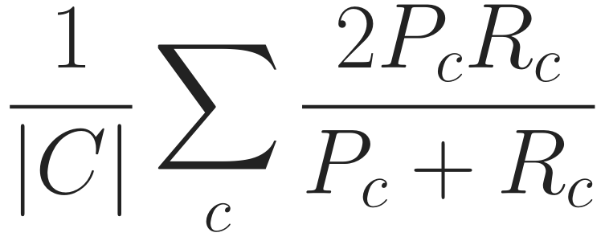
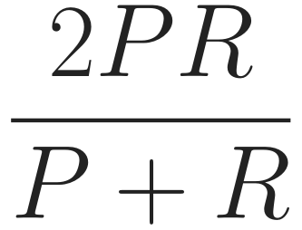
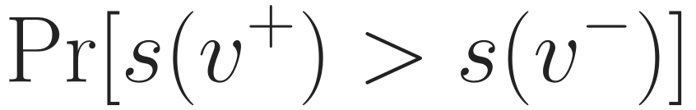
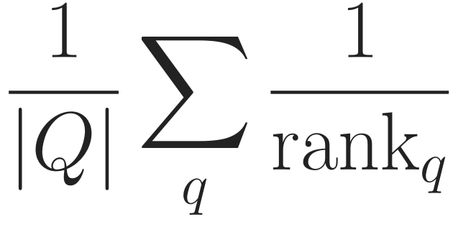
Evaluation metrics and protocol
Background
Problem
Method
Experiments
Discussion
Data
Metrics
Protocol
Cost
Ablation
Analysis
Macro-F1
Micro-F1
ROC-AUC
MRR
every class counts
overall correctness
true link above a hard negative
true link ranked first
node, graph: Macro/Micro-F1 · link: ROC-AUC, MRR (HGB 2-hop negatives)
Same data
files, splits, negatives
Tune seed 0
100 Bayesian trials
Retrain
seeds 0–4
Report
mean ± std
Test
Welch [24], raw + adj. p
Every baseline rerun under this rule, HetSheaf included
Notes:
Metrics and protocol on one slide. Node and graph tasks report Macro-F1, where every class counts equally, and Micro-F1, which equals accuracy for single-label data. Link prediction follows HGB: ROC-AUC and MRR against negatives drawn from the head's two-hop neighbourhood. The protocol is one rule for every method: the same files and splits; Bayesian search with one hundred trials on seed zero using only the validation metric; retrain the best configuration on seeds zero to four; report mean and standard deviation; and test with Welch's t-test, raw and adjusted p-values. Every baseline, HetSheaf included, is rerun this way, which answers concern 4.

Slide 30
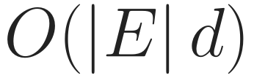
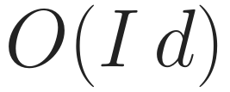
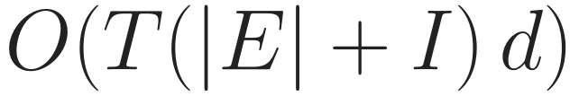
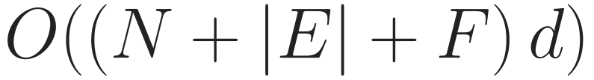
Cost: how it grows, and what we measured
Background
Problem
Method
Experiments
Discussion
Data
Metrics
Protocol
Cost
Ablation
Analysis
Growth (time unless noted)
Peak GPU memory on ACM (MB)
Maps
no d×d matrices
Faces
I = face incidences
Solve
T ≈ 10
Memory
not ∝ T
v1: O((|E|+I) d³) maps; HAN/SeHGNN: one graph per schema, can be denser than E
others: v1 Table 11; now: laptop, d = 32; time on server
Linear in edges and face incidences; ACM memory 9.3 GB → 2.8 GB (concern 3).
Notes:
Cost. Left, how it grows: maps are linear in edges times d, never d-by-d matrices; faces are linear in face incidences; the solve needs about ten passes over edges and incidences; and memory holds the states only, it does not grow with the number of solver steps. v1 built d-by-d maps at cubic cost in d, and meta-path methods such as HAN and SeHGNN build one graph per schema, which can be much denser than the original. Right, measured peak memory on ACM: v1 needed 9.3 GB; the current model 2.8 GB, below HAN and HINormer. The other bars come from the v1 paper's table on a different machine, and ours from a laptop GPU, so read it as an order of magnitude. A fair time comparison will be done on the server; the solver needs 9 to 11 steps on all three HGB datasets.

Slide 31
Ablation study: which part carries the gain?
Background
Problem
Method
Experiments
Discussion
Data
Metrics
Protocol
Cost
Ablation
Analysis
Remove or replace | If the full model wins, it shows | Answers
All faces (β = 0) | path instances add information | RQ2
Face → closing edge | a face is more than its endpoints | RQ2, concern 2
Face → feature of the head | structure beats instance features | RQ2
Weight → uniform / endpoints | who is on the path matters | RQ2
Edge maps → identity | maps are what handle heterophily | RQ1 (proposed)
Face maps → free maps | composing edge maps matters | design
One change per row, same paths and budget; the wording if it fails is fixed in advance.
Free maps as in copresheaf networks [15]; ablations, not rankings: a tuned R-GCN rivals many HGNNs [19]
Notes:
Which part carries the gain? Each row changes exactly one thing, with the same sampled paths, parameter budget and tuning. Removing all faces tests whether path instances add anything. Replacing a face by a closing edge tests whether it is more than its endpoints, reviewer concern 2. Feeding the path only to the head, as MAGNN does, tests structure against features. A uniform or endpoint-only weight tests whether who is on the path matters. These four answer RQ2. Identity edge maps test whether the maps are what handle heterophily, RQ1. Free face maps test the composition. What we write if the full model does not win is fixed before running.

Slide 32
Model analysis: when and why it works
Background
Problem
Method
Experiments
Discussion
Data
Metrics
Protocol
Cost
Ablation
Analysis
Gain vs. heterophily
Known-answer tasks
Schema read-out
gain plotted against ℋ²
label set by the intermediate node
weight per schema; stable?
RQ1
mechanism
interpretability
Path length
Scaling
Who gets weight
ℓmax = 2 … 6
memory, time vs. size, #faces
by intermediate type, label match
sensitivity
concern 3
RQ2
Ablations say which part helps; analyses say when, why, and at what cost.
Notes:
Six analyses explain when and why. Gain against H-squared tests whether the benefit grows with heterophily, RQ1. Known-answer synthetic tasks, where the label is decided by the intermediate node, test the mechanism directly. The schema read-out shows which schemas get weight and whether that is stable across seeds. Path length tests sensitivity to l-max. Scaling measures memory and time against graph size and number of faces, concern 3. And a case study of which instances get high weight, by intermediate type and whether the endpoints share a label, gives the qualitative side of RQ2.

Slide 33
What is new, and what is not
Background
Problem
Method
Experiments
Discussion
New
Not new (we say so)
Paths as faces of the graph’s own sheaf
Face reaches every node, no shortcut
Heterophily and meta-paths in one objective
Ablations as configurations of one model
Intermediate nodes: MAGNN, SGAT [12, 17]
Sheaves on typed graphs: HetSheaf [9]
The solver: personalised PageRank [16]
A special case equals MAGNN’s encoder
The contribution is where the path acts: inside one sheaf on the original graph.
Notes:
To be precise about novelty. New: paths are faces of the graph's own sheaf; a face reaches every node of its path without a shortcut; heterophily and meta-path information sit in one objective; and every ablation is a configuration of the same model. Not new: using intermediate nodes, which MAGNN and SGAT do; sheaves on typed graphs, which HetSheaf introduced; and the solver, which is personalised PageRank. With relation-only maps and the path used only as a feature, our face reduces to MAGNN's instance encoder; we state that openly.

Slide 34
Then and now: what changed since the submission
Background
Problem
Method
Experiments
Discussion
Aspect | v1 (submitted) | Now
Story | 3 contributions | heterophily on original graph; paths as structure
Face → nodes | only via closing edge | direct, every node
Propagation | K Hodge steps | one objective, one solve
Path selection | AMPSS + 4 budgets | WISP, no schema list
Node datasets | 3 (one heterophilic) | 8 across heterophily
Baselines | HetSheaf quoted | all rerun, same budget
Memory (ACM) | 9.3 GB | 2.8 GB
The core idea stayed; its weakest link (the closing edge) and the weak evidence were replaced.
Notes:
Side by side with the submitted version. The story moved from three contributions to two goals. The face used to reach nodes only through a closing edge; now it reaches every node directly. K Hodge steps became one objective and one solve. AMPSS with four budgets became WISP. Three node datasets, one of them heterophilic, became eight across the heterophily range. HetSheaf was quoted; now every baseline is rerun with the same budget. And ACM memory went from 9.3 to 2.8 GB.

Slide 35
Limitations and next steps
Background
Problem
Method
Experiments
Discussion
Limitations (stated in the paper)
Next steps (in order)
Influence is symmetric in strength; direction lives only in the maps
Propagation is linear; non-linearity is in the head
Edge states carry no input of their own (no edge features)
1
Mini-batch design for the large H2GB graphs
2
Baseline plan: coverage, search spaces, HetSheaf adapter
3
Server runs, then the analysis part
4
Analysis & Ablation Studies
Notes:
Limitations we will state. Influence is symmetric in strength: an edge or a face pulls all its members equally, and direction lives only in the maps; that is the price of having an energy with a unique solution. Propagation is linear and all non-linearity is in the head. Edge states carry no input of their own because the benchmarks have no edge features. Paths are simple, up to a maximum length, and sampled. Graph classification is typed by label. And five seeds on fixed splits measure seed variance only. Next steps, in order: the heterophily harness, starting by reproducing Hetero2Net's published values; the protocol code; the mini-batch design for the large graphs; the baseline plan including a HetSheaf adapter; and then the server runs and the analysis part.

Slide 36
Conclusion
Background
Problem
Method
Experiments
Discussion
Problem
Heterophily handled on per-schema graphs; paths reduced to endpoints
Idea
Original graph; maps for heterophily; each path instance a face
Method
One objective, one solve; WISP samples and weights paths
Next
RQ1, RQ2 on 8 + 8 + 4 datasets; ablations fixed in advance
Model implemented and tested; no accuracy numbers yet. Thank you.
Notes:
To conclude. The problem: heterophily is usually handled on per-schema graphs, and paths are reduced to their endpoints. Our idea: stay on the original graph, use learned maps for heterophily, and make each path instance a face. The method is one objective solved once, with WISP sampling and weighting the paths. Next, the two research questions are tested on node, link and graph tasks with ablations fixed in advance. The model is implemented and tested; there are no accuracy numbers yet. Thank you.

Slide 37
References
Background
Problem
Method
Experiments
Discussion
[1] Q. Lv et al. Are we really making much progress? Revisiting, benchmarking, and refining HGNNs. KDD 2021.
[2] T. N. Kipf and M. Welling. Semi-supervised classification with graph convolutional networks. ICLR 2017.
[3] J. Zhu et al. Beyond homophily in graph neural networks: Current limitations and effective designs. NeurIPS 2020.
[4] Y. Sun et al. PathSim: Meta path-based top-k similarity search in heterogeneous information networks. VLDB 2011.
[5] J. Lin et al. When heterophily meets heterogeneity: Challenges and a new large-scale graph benchmark. KDD 2025.
[6] O. Platonov et al. Characterizing graph datasets for node classification: Homophily-heterophily dichotomy and beyond. NeurIPS 2023.
[7] J. Hansen and T. Gebhart. Sheaf neural networks. arXiv:2012.06333, 2020.
[8] C. Bodnar et al. Neural sheaf diffusion: A topological perspective on heterophily and oversmoothing in GNNs. NeurIPS 2022.
[9] L. Braithwaite et al. Heterogeneous sheaf neural networks. arXiv:2409.08036, 2024.
[10] X. Wang et al. Heterogeneous graph attention network. WWW 2019.
[11] X. Yang et al. Simple and efficient heterogeneous graph neural network. AAAI 2023.
[12] X. Fu et al. MAGNN: Metapath aggregated graph neural network for heterogeneous graph embedding. WWW 2020.
Notes:
References for the citations on the slides.

Slide 38
References (cont.)
Background
Problem
Method
Experiments
Discussion
[13] I. Duta et al. Sheaf hypergraph networks. NeurIPS 2023.
[14] C. Bodnar et al. Weisfeiler and Lehman go cellular: CW networks. NeurIPS 2021.
[15] M. Hajij et al. Copresheaf topological neural networks: A generalized deep learning framework. NeurIPS 2025.
[16] J. Gasteiger et al. Predict then propagate: Graph neural networks meet personalized PageRank. ICLR 2019.
[17] S. H. Lee et al. SGAT: Simplicial graph attention network. IJCAI 2022.
[18] J. Li et al. Heterophily-aware representation learning on heterogeneous graphs (Hetero²Net). IEEE TPAMI 2025.
[19] X. Yang et al. Are heterogeneous graph neural networks truly effective for node classification? A causal perspective. arXiv:2510.05750, 2025.
[20] J. Guo et al. Homophily-oriented heterogeneous graph rewiring. WWW 2023.
[21] Z. Shen and Z. Kang. When heterophily meets heterogeneous graphs: Latent graphs guided unsupervised representation learning. IEEE TNNLS 2025.
[22] X. Fu and I. King. MECCH: Metapath context convolution-based heterogeneous graph neural networks. Neural Networks 2024.
[23] C. Morris et al. TUDataset: A collection of benchmark datasets for learning with graphs. ICML GRL+ Workshop 2020.
[24] B. L. Welch. The generalization of “Student’s” problem when several different population variances are involved. Biometrika 1947.
Notes:
References for the citations on the slides.

Slide 39
References (cont.)
Background
Problem
Method
Experiments
Discussion
[25] S. Yun et al. Graph transformer networks. NeurIPS 2019.
[26] C. Li et al. Long-range meta-path search on large-scale heterogeneous graphs (LMSPS). NeurIPS 2024.
[27] Q. Chen and G. Song. Adaptive heterogeneous graph neural networks: Bridging heterophily and heterogeneity. CIKM 2025.
[28] J. Kim et al. Leveraging multi-facet paths for heterogeneous graph representation learning (MF2Vec). arXiv:2407.20648, 2024.
[29] C. Li, H. Xu and K. He. Differentiable meta multigraph search with partial message propagation (PMMM). AAAI 2023.
[30] X. Li et al. Adaptive meta-path-based neural architecture search for heterogeneous graphs (AMP-HGNAS). Information Sciences 2026.
[31] B. Zhang et al. A new meta-path Monte Carlo tree search algorithm for HGNNs. Machine Intelligence Research 2026.
Notes:
References for the citations on the slides.

Slide 40
Backup slide
Background
Problem
Method
Experiments
Discussion
Notes:
References for the citations on the slides.

Slide 41
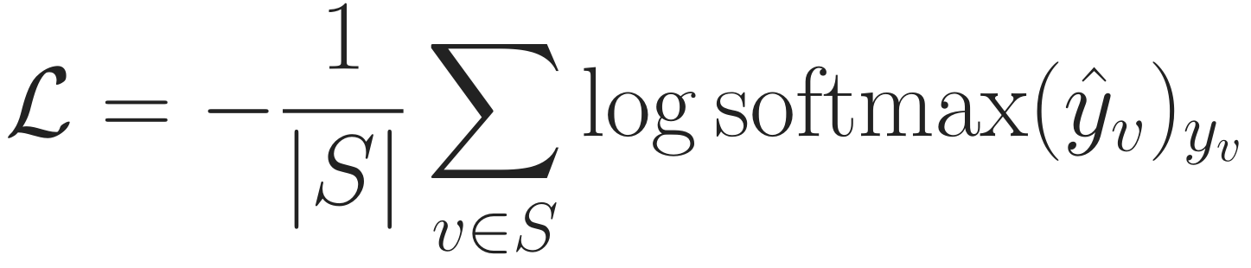
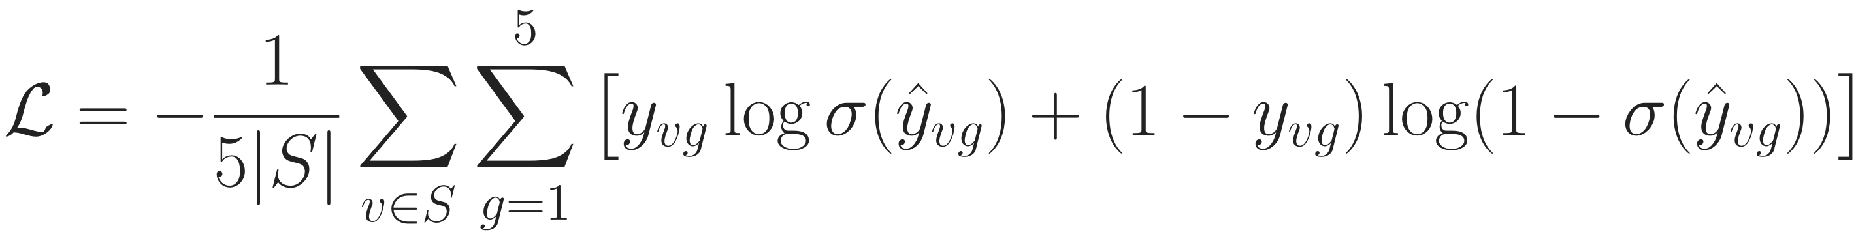
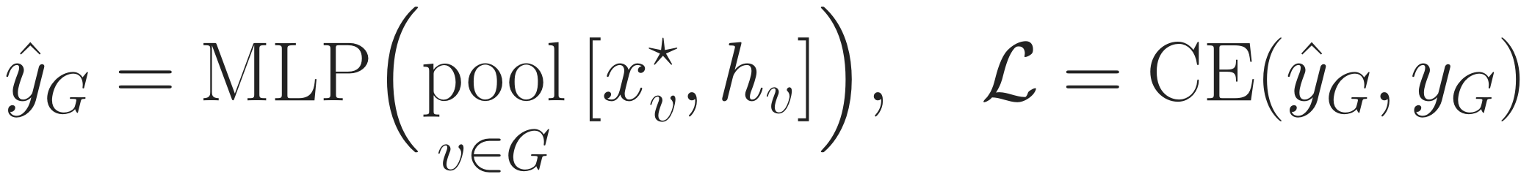
Training: the loss for each downstream task
Background
Problem
Method
Experiments
Discussion
Overview
Encode
WISP
Faces
Energy
Solve
Train
Node classification
cross-entropy on labelled training nodes
IMDB (multi-label)
one binary loss per genre; predict genre if logit > 0
Link prediction
z = [x*, h]; one negative per positive; decoder as in HGB
Graph classification
pool ∈ {mean, max, add, attention}; no new readout
The propagation is the same for all tasks; only the head and the loss change.
Notes:
The loss depends on the task; the propagation does not. Node classification uses cross-entropy on the labelled training nodes. IMDB is multi-label with five genres, so it uses one binary cross-entropy per genre, and a genre is predicted when its logit is positive; this is how HGB, SeHGNN and HetSheaf treat it. Link prediction scores a pair with a decoder on the two node representations, here x-star and h concatenated, and uses binary cross-entropy with one sampled negative per positive; the decoder is the one of the HGB protocol, the same for every method. Graph classification pools the same node readout over the graph's nodes, with mean, max, add or attention pooling as HetSheaf's baselines use, and a cross-entropy loss. We deliberately add no new readout component, which reviewers had criticised in v1.

Slide 42
Datasets (1): node classification, small to large
Background
Problem
Method
Experiments
Discussion
Datasets
Heterophily
Metrics
Protocol
Cost
Ablation
Analysis
Dataset | Source | Nodes | Node types | Target (classes) | Training
ACM | HGB [1] | 10,942 | 4 | paper (3) | full graph
DBLP | HGB [1] | 26,128 | 4 | author (4) | full graph
IMDB | HGB [1] | 21,420 | 4 | movie (5, multi-label) | full graph
Freebase | HGB [1] | 180,098 | 8 | book (7) | full graph*
IEEE-CIS-G | H2GB [5] | 153,880 | 12 | transaction (2) | full or mini-batch
mag-year | H2GB [5] | 1,939,743 | 4 | paper (5) | mini-batch
ogbn-mag | H2GB [5] | 1,939,743 | 4 | paper (349) | mini-batch
H-Pokec | H2GB [5] | 1,731,977 | 16 | user (2) | mini-batch
Splits: HGB 24/6/70, H2GB its own. *Freebase memory not yet measured
Four HGB graphs plus four large H2GB graphs, chosen to span the heterophily range.
Notes:
Node classification uses eight datasets. Four come from HGB: ACM, DBLP, IMDB and Freebase, trained on the full graph with HGB's official 24/6/70 splits. Four come from H2GB, the large benchmark for heterophilic heterogeneous graphs: IEEE-CIS-G for fraud, mag-year and ogbn-mag on the same academic graph with different targets, and the social network H-Pokec, with their own splits. The three large ones need mini-batch training, which still has to be designed. The rule for every dataset: it must have node attributes or target labels. This set answers reviewer concern 1: it spans the heterophily range, not just IMDB.

Slide 43
Datasets (2): link prediction and graph classification
Background
Problem
Method
Experiments
Discussion
Datasets
Heterophily
Metrics
Protocol
Cost
Ablation
Analysis
Link-prediction task | Graph | Target relation
ACM P–A, DBLP A–P, IMDB M–A | HGB, derived | paper–author, author–paper, movie–actor
Freebase B–B | HGB, derived | book–book (split by unordered pair)
PubMed, LastFM | HGB link sets | disease–disease, user–artist
ogbn-mag P–P, H-Pokec U–U | H2GB graphs | citation, friendship (large)
Leaking features removed in every task.
Graph classification (appendix) | Graphs | Classes | Types
MUTAG, PROTEINS, ENZYMES, NCI1 (TU [23]) | 188 – 4,110 | 2 – 6 | from atom / structure labels
Graph classification shows coverage only: its types come from labels, so no heterophily claim.
Notes:
Link prediction has eight tasks under one protocol. Four are derived from the node-classification graphs, so node types and node labels are real: paper-author on ACM, author-paper on DBLP, movie-actor on IMDB, and book-book on Freebase. Two are HGB's own link sets, PubMed and LastFM; LastFM has neither features nor labels and is kept as the one stated exception. Two large tasks, citation on ogbn-mag and friendship on H-Pokec, test scale. In every task, features that are computed from the target relation are removed, because they would leak the answer. Graph classification uses the four TU datasets of HetSheaf. Their node types come from atom or structure labels, which reviewers rightly said is not a natural heterogeneous graph, so this task only shows that the model covers it, with no heterophily claim.

Slide 44
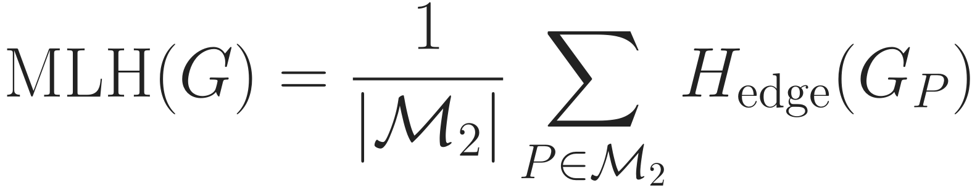
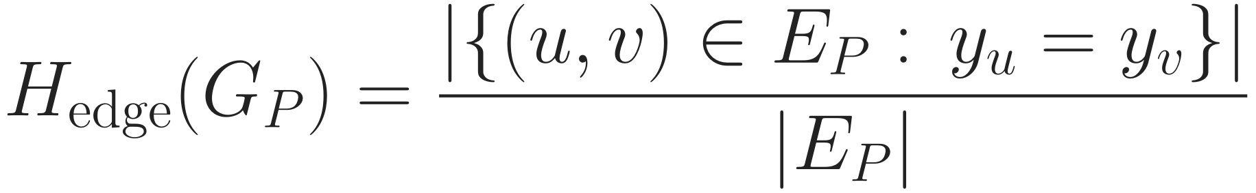
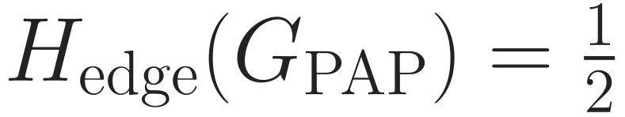
Heterophily metric (1): MLH, do linked nodes share a label?
Background
Problem
Method
Experiments
Discussion
Datasets
Heterophily
Metrics
Protocol
Cost
Ablation
Analysis
Example: PAP on our graph
P1
P9
different
P1
P4
same
Symbol | Meaning
ℳ₂ | meta-paths of length 2, target type to target type
G_P | graph P induces on target nodes (PAP: shared author)
y | class label of a target node
MLH | near 1: linked nodes share labels; near 0: heterophilic
Meta-path set ℳ₂ (from Hetero²Net [18])
ACM | PAP, PSP, PTP
DBLP | APA
IMDB | MDM, MAM, MKM
ogbn-mag | PFP, PAP
others | its get_metapaths rule
Purpose: label agreement; ℋ² [5, 6] corrects it for class imbalance.
Notes:
Two heterophily metrics are new in the evaluation. The first is MLH, meta-path-based label homophily, from Hetero2Net. Take every meta-path of length two from the target type back to itself, such as PAP. Each defines a graph on target nodes; on it, H-edge is the fraction of edges whose two ends share a label. MLH averages that over the meta-paths. On our example the PAP graph has two edges, P1-P9 with different labels and P1-P4 with the same label, so H-edge is one half. Near one means homophilic, near zero heterophilic. It is the plain label view; the H-squared index from the background slide is the same idea corrected for class imbalance, and that is what we use to stratify results. All three metrics use the same meta-path set, Hetero2Net's list where it exists and its own rule otherwise. Before reporting, we must reproduce Hetero2Net's published values on DBLP, ACM and IMDB.

Slide 45


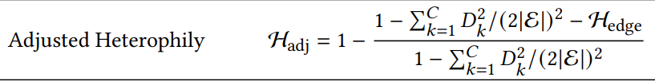
Background
Problem
Method
Experiments
Discussion
Datasets
Heterophily
Metrics
Protocol
Cost
Ablation
Analysis
Heterophily metric (2): H², MLH with robustness against class imbalance
𝒫₂
Homogeneous Subgraph from l =2 meta-paths
G_{p}
paper graph that meta-path p induces
h_{adj}
homophily corrected for class imbalance
y: node label
near 1: homophily
near 0: heterophily
Notes:
On a typed graph, labels are compared between papers, so heterophily is measured on the paper graphs that meta-paths induce. The H2GB benchmark defines the index H-squared: for each length-two meta-path, build the induced paper graph, measure its adjusted homophily, which corrects for class imbalance, and average one minus that value. Zero means homophilic; around one, heterophilic. The chart shows our values: DBLP is homophilic, IMDB clearly heterophilic, IEEE-CIS-G and Freebase almost fully heterophilic. Freebase is dominated by unlabeled books, which the reference code fills at random; we also report a labeled-only value. With this range we can test whether gains grow with heterophily.

Slide 46
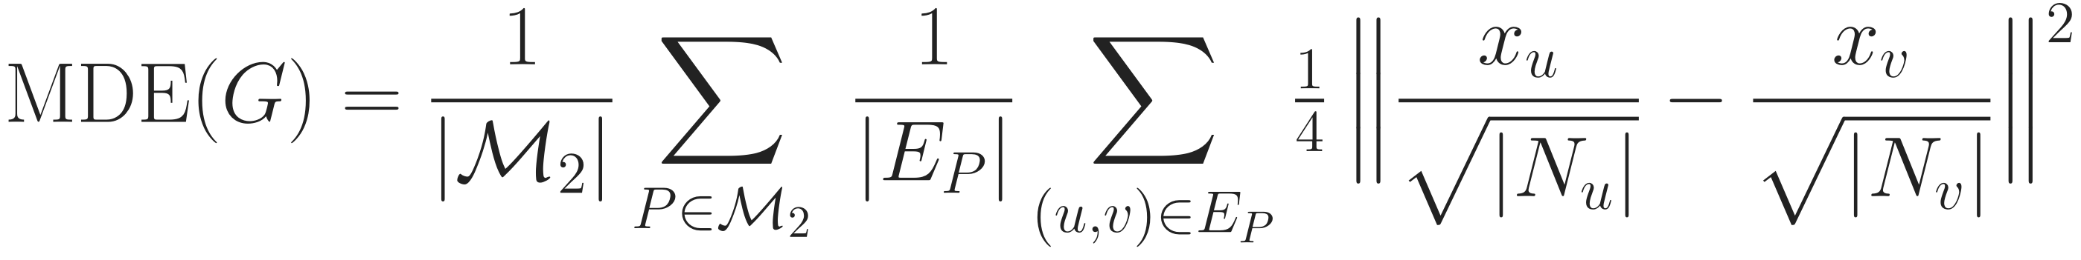
Heterophily metric (3): MDE, do linked nodes look alike?
Background
Problem
Method
Experiments
Discussion
Datasets
Heterophily
Metrics
Protocol
Cost
Ablation
Analysis
Symbol | Meaning
xᵤ | raw feature vector of target node u
Nᵤ | neighbours of u in G_P (degree normalises)
E_P | edges of the meta-path graph G_P
MDE | large: linked nodes have different features
 | Node | Link | Graph
MLH | ✓ | labelled ends | 1-hop*
ℋ² | ✓ | labelled ends | –
MDE | ✓⁺ | kept features | –
* label = atom type ⁺ not Freebase (no features)
Purpose: feature disagreement; describes a dataset (scale-dependent).
Check first: reproduce Hetero²Net [18]: MLH 0.87/0.60/0.24, MDE 0.80/0.74/0.59 (DBLP/ACM/IMDB)
Labels (MLH, ℋ²) and features (MDE) can disagree; reporting both answers reviewer concern 1.
Notes:
The second metric, MDE, is the meta-path Dirichlet energy, also from Hetero2Net. It looks at features instead of labels: for every edge of a meta-path graph it measures how different the two degree-normalised feature vectors are, then averages. Large MDE means linked nodes look different, which is attribute heterophily. It depends on the scale of the features, so we use it to describe each dataset, not to rank datasets against each other. The table shows where each metric can be computed: all three on node classification except MDE on Freebase, which has no features; on link prediction where the endpoints have labels or kept features; and on graph classification only a one-hop edge homophily with atom type as label. Before reporting anything we must reproduce Hetero2Net's published values within a tolerance fixed in advance.

Slide 47
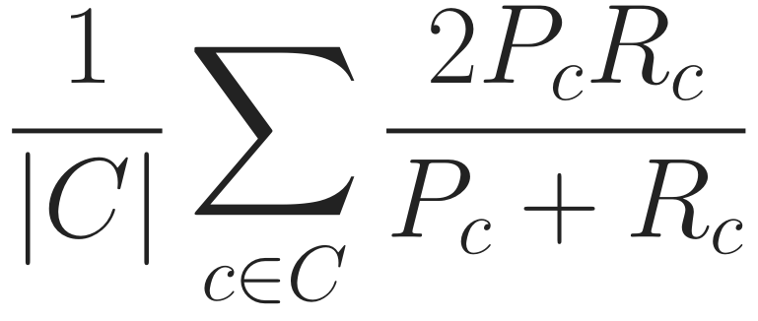
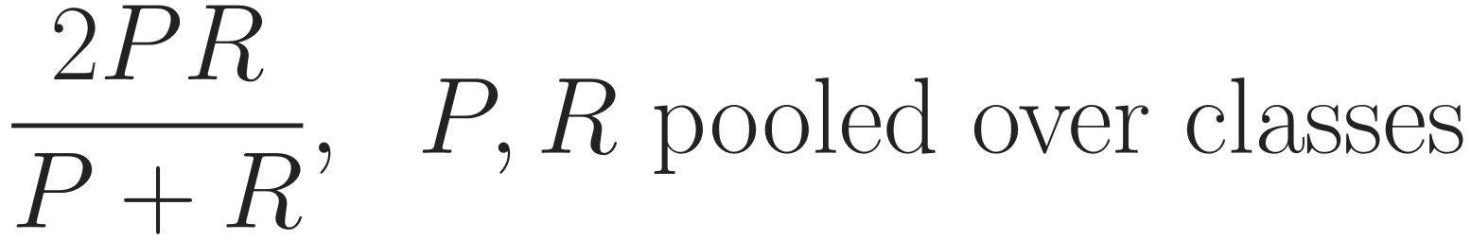
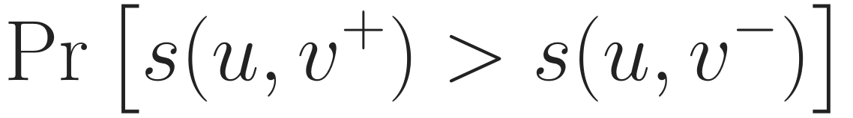
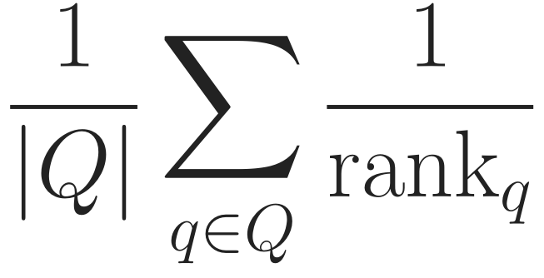
Evaluation metrics
Background
Problem
Method
Experiments
Discussion
Datasets
Heterophily
Metrics
Protocol
Cost
Ablation
Analysis
Macro-F1 (node, graph)
Micro-F1 (node, graph)
Pc, Rc: precision, recall of class c; C: classes in the split
Purpose: every class counts equally, even rare ones
single-label: equals accuracy
Purpose: overall correctness
ROC-AUC (link)
MRR (link)
s: model score; v⁻: 2-hop negative, 1 per positive
Purpose: true link ranked above a hard negative
rank of the true tail among its head’s candidates
Purpose: rewards putting the true link first
Model selection: validation Macro-F1 (node, graph), validation ROC-AUC (link); fixed before running.
Notes:
These are the metrics, each with its purpose. Macro-F1 averages the F1 score over classes, so rare classes count as much as frequent ones; we average only over classes that occur in the split's true labels, which matters for ogbn-mag with 349 venues. Micro-F1 pools all decisions; for single-label data it equals accuracy. For link prediction we follow HGB: ROC-AUC, the probability that a true link scores higher than a negative drawn from the head's two-hop neighbourhood, and MRR, the mean reciprocal rank of the true link. Which validation metric selects configurations and checkpoints is fixed before running: Macro-F1 for node and graph tasks, ROC-AUC for links.

Slide 48
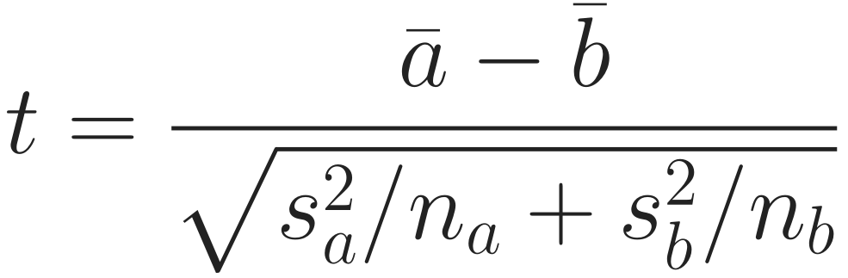
Protocol: one rule for every method
Background
Problem
Method
Experiments
Discussion
Datasets
Heterophily
Metrics
Protocol
Cost
Ablation
Analysis
Shared data
files, splits, negatives
Tune on seed 0
100 Bayesian trials
Retrain
best config, seeds 0–4
Report
mean ± std
Test
Welch, raw + adj. p
Welch [24]: unequal variances; vs. the best other method; a better baseline is reported too
Reviewer concern | What the protocol does
Baseline tuning not described | same search budget (100 trials) and rule for every method; spaces published
HetSheaf quoted from its paper | every baseline rerun on our data, HetSheaf included
How std was computed | fixed splits; std over 5 training seeds; Welch test on every metric
Each method keeps its own feature preprocessing (as in its code); everything else is shared.
Notes:
The protocol is one rule for every method. All methods read the same files, splits and negatives. Each is tuned with Bayesian search, one hundred trials, on seed zero, using only the validation metric; the best configuration is then retrained on seeds zero to four, and we report mean and standard deviation. For significance we use Welch's t-test, which does not assume equal variances; we compare H2S-NN with the best other method on each metric and report it honestly if a baseline is better, with raw and adjusted p-values. Our own search space is small: dimension, learning rate, weight decay and two dropouts; the walk length, number of walks and solver tolerance are fixed and never tuned. The table maps this to reviewer concern 4. One exception by design: each method keeps the feature preprocessing of its original code.

Slide 49
Hyperparameters: what is tuned, fixed and learned, per step
Background
Problem
Method
Experiments
Discussion
Datasets
Heterophily
Metrics
Protocol
Cost
Ablation
Analysis
Step | Tuned (searched) | Fixed (set once, never tuned) | Learned
1 Encode | d, encoder dropout | – | type encoders
2 Edge maps | – | 2 reflections, MLP width 128 | map MLP, frames, aₑ
3 WISP | – | ℓmax = 4, walks r (calibrated), q = p | weight MLP g
4 Energy | – | normalisation | –
5 Solve | – | tolerance 1e-4, max 100 steps | τ
6 Head | classifier dropout | width 128 (GC: pooling tuned) | MLP
Training | learning rate, weight decay | AdamW, cosine, clip 1.0, epochs | –
9 + 4
v1 (submitted)
tuned + budgets
5 + 2
Now
tuned + fixed
v1 also tuned diffusion steps K and two step sizes.
Notes:
Reviewers asked how many choices the model hides. This table lists every knob, step by step. Red entries are the only ones we search: the dimension d, two dropouts, learning rate and weight decay, five in total, plus the pooling type for graph classification. Everything in the third column is fixed once and never tuned: two reflections per map, the maximum walk length 4 on HGB, the number of walks per node, which is calibrated by a fixed rule, the solver tolerance and step limit. The last column is learned by gradient descent; tau, the strength of agreement, is learned rather than tuned. v1 searched nine hyperparameters, including the number of diffusion steps and two step sizes, and needed four hand-set budgets for schemas, instances, incidences and length; now it is five tuned, plus two fixed path settings, the maximum length and the number of walks, which are set by a rule before any run.

Slide 50
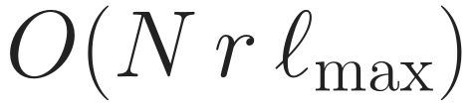
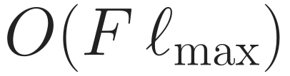
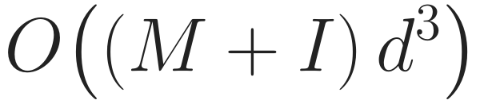
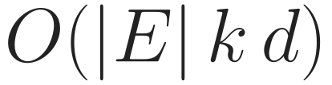
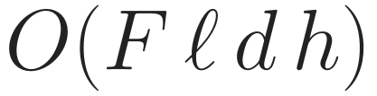
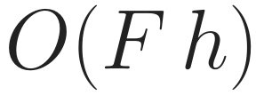
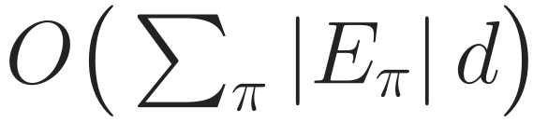
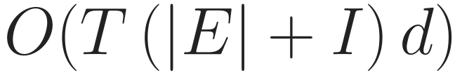



Cost (1): how time and memory grow
Background
Problem
Method
Experiments
Discussion
Datasets
Heterophily
Metrics
Protocol
Cost
Ablation
Analysis
Step | Time | Memory
WISP draw (CPU)
Edge maps
Instance weights g
Solve: T steps
Backward: 1 solve
Compared with
v1
d×d maps; memory grows with K
HAN, SeHGNN
schema graphs can be denser than E
MAGNN
N nodes, |E| edges, F faces, I face incidences, k = 2 reflections, T ≈ 10 CG steps
every instance of every schema
Linear in edges and face incidences; d, not d³; memory does not grow with solver steps.
Notes:
How cost grows, step by step. Drawing walks costs nodes times walks per node times the maximum length, on the CPU. Edge maps cost linear in edges times d, because each map is two reflections, never a d-by-d matrix. The instance weights cost linear in the number of faces. One application of the operator is linear in edges plus face incidences; the solve needs T of them, about ten in practice, and so does the backward solve. Memory holds the states of nodes, shared edges and faces, and does not grow with T because we differentiate implicitly. For comparison, v1 built d-by-d maps at cubic cost in d and stored states for every diffusion step. Meta-path methods such as HAN and SeHGNN pay for the edges of each per-schema graph, which can be far denser than the original graph; MAGNN pays for every instance of every schema. These are the standard orders, not measurements.

Slide 51
Cost (2): measured memory and solver steps
Background
Problem
Method
Experiments
Discussion
Datasets
Heterophily
Metrics
Protocol
Cost
Ablation
Analysis
Peak GPU memory on ACM (MB)
H2S-NN now | ACM | DBLP | IMDB
Faces (eval draw) | 103k | 207k | 38k
Peak memory | 2.8 GB | 5.0 GB | 1.3 GB
CG steps (fwd/bwd) | 9 / 8 | 11 / 10 | 10 / 10
Epoch time | 4.3 s | 6.2 s | 3.1 s
CG steps stay at 9–11 while the state grows 4×.
Time: laptop session ran slow; v1 3.0 s/epoch on ACM; fair timing on the server.
Others: v1 paper Table 11. Now: laptop GPU, d = 32.
Memory on ACM: 9.3 GB (v1) → 2.8 GB now, inside the range of common baselines.
Notes:
Measured cost. Left: peak GPU memory on ACM. The baseline numbers and v1 come from Table 11 of the submitted paper, measured on that machine; our current number comes from a laptop GPU at dimension 32, so read the comparison as an order of magnitude. v1 needed 9.3 GB; the current model needs 2.8 GB, between H2G-former and HINormer and below HAN. Right: the current model on three datasets. The number of conjugate-gradient steps stays at 9 to 11 while the state grows four times from IMDB to DBLP, which is what the conditioning bound predicts. Time per epoch was 4.3 seconds on ACM, but the laptop was running slow in that session, about two times slower than usual on the model-independent sampling, so a fair time comparison against v1 and the baselines will be measured on the server under the same conditions. Reviewer concern 3 also asks for scaling curves; those are in the analysis plan.

Slide 52
Ablation study: which part carries the gain?
Background
Problem
Method
Experiments
Discussion
Datasets
Heterophily
Metrics
Protocol
Cost
Ablation
Analysis
Remove or replace | If the full model wins, it shows | Answers
All faces (weight 0) | path instances add information | RQ2
Face → closing edge | a face is more than its endpoints | RQ2, concern 2
Face → feature of the head | structure beats instance features | RQ2
Weight: uniform / schema / endpoints | who is on the path matters | thesis, concern 5
Node–face term | a face must reach nodes directly | design
Face maps → free maps | composed maps matter | design
Orthogonal → diagonal maps | relation order matters | design
Same sampled paths, same parameter budget, same tuning; shaded rows decide RQ2.
Each row isolates one component, as reviewers asked; the result we will write is fixed before running.
Notes:
The ablation study answers one question: which part carries the gain. Each row removes or replaces exactly one component, with everything else held equal: same sampled paths, same parameter budget, same tuning. The first three rows decide RQ2. Removing all faces tests whether path instances add anything. Replacing each face by a closing edge between its ends tests whether a face is more than its endpoints, which is reviewer concern 2. Using the face only as a feature of the classifier is the MAGNN-type instance encoder; if the full model wins, structure beats features. The weight ladder, uniform, schema only, endpoints only, full, tests whether it matters who is on the path. The last three rows test design choices: the direct node-face term, composing face maps from edge maps instead of learning them freely, and orthogonal maps that respect relation order. For every row we wrote down in advance what the paper says if the full model does not win.

Slide 53
Model analysis: when and why it works
Background
Problem
Method
Experiments
Discussion
Datasets
Heterophily
Metrics
Protocol
Cost
Ablation
Analysis
Gain vs. heterophily
Known-answer tasks
Schema read-out
gain over the best baseline and over “no faces”, plotted against ℋ²
synthetic graphs where the label depends on the intermediate node
share of weight per schema; stable across seeds?
RQ1, concern 1
mechanism
interpretability
Path length
Scaling
Who gets weight
accuracy for ℓmax = 2 … 6
memory, time, CG steps vs. graph size and #faces
weights of instances by intermediate type and label agreement
sensitivity
concern 3
RQ2, case study
Ablations say which part helps; analyses say when, why, and at what cost.
Notes:
Beyond ablations, six analyses explain when and why the model works. First, gain against heterophily: if handling heterophily with paths is real, the gain should grow with H-squared across the eight datasets; this is RQ1 and reviewer concern 1. Second, known-answer tasks: small synthetic graphs where the label is decided by the intermediate node, so we can check that the mechanism does what we claim, separate from benchmark noise. Third, the schema read-out: which schemas receive weight, and whether that is stable across seeds; this replaces v1's schema selection as the interpretable output. Fourth, sensitivity to the maximum path length. Fifth, scaling of memory, time and solver steps with graph size and number of faces, reviewer concern 3. Sixth, a case study of which instances receive high weight, for example by the type of the intermediate node and whether the endpoints share a label.

Slide 54
What is new, and what is not
Background
Problem
Method
Experiments
Discussion
New
Not new (we say so)
Paths as faces of the graph’s own sheaf
Face reaches every node, no shortcut
Heterophily on the original graph
Controls are configurations of one model
Intermediate nodes: MAGNN, SGAT [12, 17]
Sheaves on typed graphs: HetSheaf [9]
The solver: personalised PageRank [16]
Special case = MAGNN’s instance encoder
The contribution is where the path acts (inside one sheaf on the original graph), not that paths are used.
Notes:
To be precise about novelty. New: path instances become faces of the same sheaf as the graph, with maps composed from the edge maps; a face reaches every node of its path, including A7, without a shortcut edge; heterophily is handled on the original graph without per-schema branches; and because there is one energy, every control is a configuration. Not new: using intermediate nodes, which MAGNN and SGAT already do; sheaf networks on typed graphs, which HetSheaf introduced; and the solver, which is personalised PageRank. There is also a special case we state openly: with relation-only maps and the face used only as a feature, our face equals MAGNN's instance encoder. So the contribution is where the path acts, not the fact that paths are used.

Slide 55
Then and now (1/2): story and model
Background
Problem
Method
Experiments
Discussion
Aspect | v1 (submitted, WSDM 2027) | Now
Story | keep path instances as 2-cells; 3 contributions | heterophily on the original graph; paths as structure; 2 goals
Path cell | 2-cell closed by a synthetic closing edge | face above its path; no closing edge
Face → nodes | only through the closing edge (proved 0 otherwise) | direct, to every node of the path
Propagation | K Hodge diffusion steps on nodes and edges | one energy, one solve; no depth K
Path selection | AMPSS: DFS over schemas + 3 budgets | WISP: random walks, no schema list
Instance weight | within selected schemas | every instance, from its nodes and relations
Graph readout | SheafCovPool (new component) | plain pooling; no new component
Memory, ACM | 9.3 GB | 0.30× v1 (laptop GPU, d = 32)
Two components were dropped; the core idea was kept and its weakest link (the closing edge) removed.
Notes:
A side-by-side comparison with the submitted version. The story changed from 'keep path instances as 2-cells', with three contributions, to two goals: handle heterophily on the original graph, and use paths as structure. The path cell was closed by a synthetic edge; now a face sits above its path with no closing edge, so the face reaches every node of its path directly, where before it reached them only through that edge. K steps of Hodge diffusion became one energy and one solve. AMPSS, which enumerated schemas and needed three budgets, became WISP, which needs no schema list and weights every instance. SheafCovPool was dropped; graph classification uses plain pooling. Measured memory on ACM is about 0.3 times v1 on a laptop GPU at dimension 32; server numbers are still to come.

Slide 56
Then and now (2/2): evaluation
Background
Problem
Method
Experiments
Discussion
Aspect | v1 (submitted) | Now
Node classification | DBLP, ACM, IMDB (one strongly heterophilic) | 8 datasets incl. 4 large H2GB graphs
Link prediction | Amazon, YouTube (one node type), LastFM, PubMed | 8 tasks with real types; leak-free features
Graph classification | 10-fold × 5 seeds; claimed heterogeneous | HetSheaf’s protocol; typed by label, stated
Heterophily evidence | MLH only | MLH, ℋ², MDE; gains vs. ℋ²
Baselines | HetSheaf quoted; tuning not described | all rerun, 100 Bayesian trials each
Statistics | mean ± std | 5 seeds + Welch’s t-test, raw and adjusted p
Ablations | single dataset, within std | controls as configurations, pre-registered
Each row answers one reviewer concern; none of it has been run yet.
Notes:
The evaluation changed more than the model. Node classification goes from three HGB datasets, of which only IMDB was strongly heterophilic, to eight, including four large H2GB graphs. Link prediction drops the single-node-type graphs Amazon and YouTube and uses eight tasks with real node types and leak-free features. Graph classification follows HetSheaf's protocol and is stated as typed by label. Heterophily evidence goes from MLH alone to three metrics plus an analysis of gains against H-squared. Every baseline, HetSheaf included, is rerun with the same tuning budget, and results come with Welch tests. To be clear: none of this has been run yet.

Slide 57
Limitations and next steps
Background
Problem
Method
Experiments
Discussion
Limitations (stated in the paper)
Next steps (in order)
Influence is symmetric in strength; direction lives only in the maps
Propagation is linear; non-linearity is in the head
Edge states carry no input of their own (no edge features)
1
Mini-batch design for the large H2GB graphs
2
Baseline plan: coverage, search spaces, HetSheaf adapter
3
Server runs, then the analysis part
4
Analysis & Ablation Studies
Notes:
Limitations we will state. Influence is symmetric in strength: an edge or a face pulls all its members equally, and direction lives only in the maps; that is the price of having an energy with a unique solution. Propagation is linear and all non-linearity is in the head. Edge states carry no input of their own because the benchmarks have no edge features. Paths are simple, up to a maximum length, and sampled. Graph classification is typed by label. And five seeds on fixed splits measure seed variance only. Next steps, in order: the heterophily harness, starting by reproducing Hetero2Net's published values; the protocol code; the mini-batch design for the large graphs; the baseline plan including a HetSheaf adapter; and then the server runs and the analysis part.

Slide 58
Conclusion
Background
Problem
Method
Experiments
Discussion
Problem
Heterophily handled on per-schema graphs; paths reduced to endpoints
Idea
Original graph; each path instance a face reaching all its nodes
Method
One energy, one solve; WISP samples and weights paths
Evidence plan
RQ1, RQ2 on 8 + 8 + 4 datasets; controls fixed in advance
Status: model implemented and checked; no accuracy numbers yet. Thank you.
Notes:
To conclude. The problem: most methods handle heterophily on derived, per-schema graphs, and reduce a path to its two endpoints. Our idea: keep the original graph and make each path instance a face whose maps are composed from the edge maps, reaching every node it passes, with no closing edge. The method is one energy over nodes, edges and faces, solved once, with WISP sampling paths without a schema list and weighting each. The two research questions will be tested on node, link and graph tasks under one protocol, with the controls and their interpretation fixed in advance. The model is implemented and checked for correctness; there are no accuracy numbers yet. Thank you, I am happy to take questions.

Slide 59
References
Background
Problem
Method
Experiments
Discussion
[1] Q. Lv et al. Are we really making much progress? Revisiting, benchmarking, and refining HGNNs. KDD 2021.
[2] T. N. Kipf and M. Welling. Semi-supervised classification with graph convolutional networks. ICLR 2017.
[3] J. Zhu et al. Beyond homophily in graph neural networks: Current limitations and effective designs. NeurIPS 2020.
[4] Y. Sun et al. PathSim: Meta path-based top-k similarity search in heterogeneous information networks. VLDB 2011.
[5] J. Lin et al. When heterophily meets heterogeneity: Challenges and a new large-scale graph benchmark. KDD 2025.
[6] O. Platonov et al. Characterizing graph datasets for node classification: Homophily-heterophily dichotomy and beyond. NeurIPS 2023.
[7] J. Hansen and T. Gebhart. Sheaf neural networks. arXiv:2012.06333, 2020.
[8] C. Bodnar et al. Neural sheaf diffusion: A topological perspective on heterophily and oversmoothing in GNNs. NeurIPS 2022.
[9] L. Braithwaite et al. Heterogeneous sheaf neural networks. arXiv:2409.08036, 2024.
[10] X. Wang et al. Heterogeneous graph attention network. WWW 2019.
[11] X. Yang et al. Simple and efficient heterogeneous graph neural network. AAAI 2023.
[12] X. Fu et al. MAGNN: Metapath aggregated graph neural network for heterogeneous graph embedding. WWW 2020.
Notes:
References for the citations on the slides.

Slide 60
References (cont.)
Background
Problem
Method
Experiments
Discussion
[13] I. Duta et al. Sheaf hypergraph networks. NeurIPS 2023.
[14] C. Bodnar et al. Weisfeiler and Lehman go cellular: CW networks. NeurIPS 2021.
[15] M. Hajij et al. Copresheaf topological neural networks: A generalized deep learning framework. NeurIPS 2025.
[16] J. Gasteiger et al. Predict then propagate: Graph neural networks meet personalized PageRank. ICLR 2019.
[17] S. H. Lee et al. SGAT: Simplicial graph attention network. IJCAI 2022.
[18] J. Li et al. Heterophily-aware representation learning on heterogeneous graphs (Hetero²Net). IEEE TPAMI 2025.
[19] X. Yang et al. Are heterogeneous graph neural networks truly effective for node classification? A causal perspective. arXiv:2510.05750, 2025.
[20] J. Guo et al. Homophily-oriented heterogeneous graph rewiring. WWW 2023.
[21] Z. Shen and Z. Kang. When heterophily meets heterogeneous graphs: Latent graphs guided unsupervised representation learning. IEEE TNNLS 2025.
[22] X. Fu and I. King. MECCH: Metapath context convolution-based heterogeneous graph neural networks. Neural Networks 2024.
[23] C. Morris et al. TUDataset: A collection of benchmark datasets for learning with graphs. ICML GRL+ Workshop 2020.
[24] B. L. Welch. The generalization of “Student’s” problem when several different population variances are involved. Biometrika 1947.
Notes:
References for the citations on the slides.

Slide 61
Appendix: terms used in this talk
Background
Problem
Method
Experiments
Discussion
Term | Meaning
Heterogeneous graph | nodes and edges have types
Heterophily | linked nodes tend to have different labels (or features)
Meta-path schema | a type pattern, e.g. paper–author–paper (PAP)
Path instance | one concrete walk that follows it, e.g. P1–A7–P9
Restriction map F | learned map from a node into the space of an edge
Face | a cell placed above one sampled path instance (no closing edge)
Energy | sum of disagreements between touching cells, after the maps
WISP | Walk-sampled, Instance-weighted Sheaf Paths: the sampler + weights
τ | learned strength of agreement in the solve
Notes:
Glossary for questions.

